Slide 1
Server Sent Events and Web Sockets

Slide 2
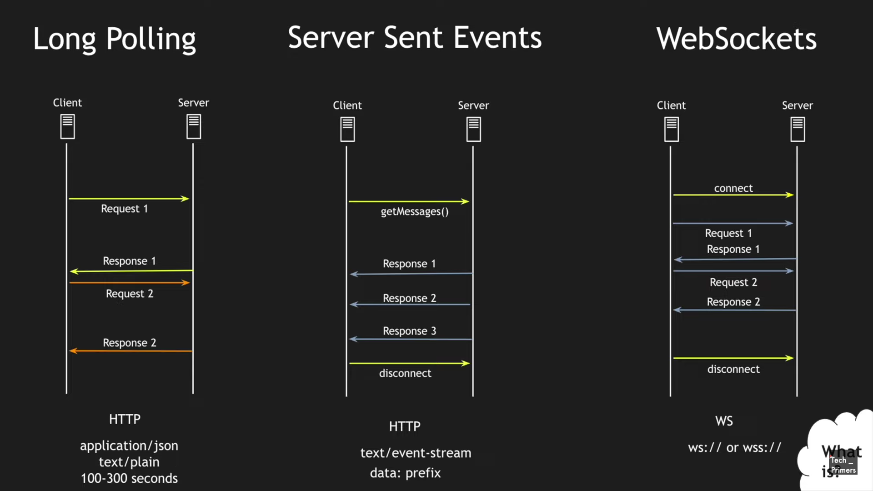

Slide 3
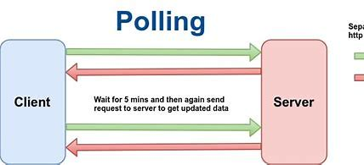
Polling : request → response. Creates a connection to the server, sends request headers with optional data, gets a response from the server, and closes the connection. Supported in all major browsers.
Supports unidirectional communication where only server can send the data on clients request.
Uses HTTP protocol for the communication.
Avoid polling as its an old technique to get the data from the server.

Slide 4
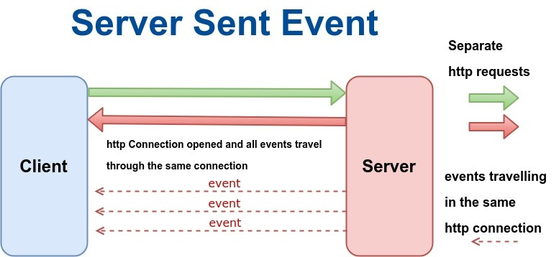
Server Sent Events : request → wait → response. Creates a connection to the server, but maintains a keep-alive connection open for some time (not long though). During connection, the open client can receive data from the server.

Slide 5
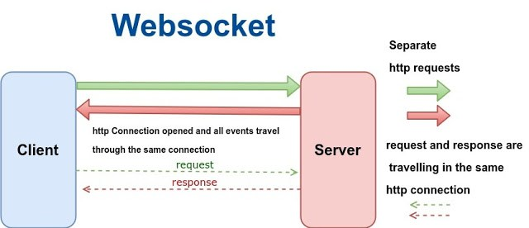
WebSockets : client ↔ server. Create a TCP connection to the server, and keep it open as long as needed. The server or client can easily close the connection. The client goes through an HTTP compatible handshake process. If it succeeds, then the server and client can exchange data in both directions at any time.

Slide 6
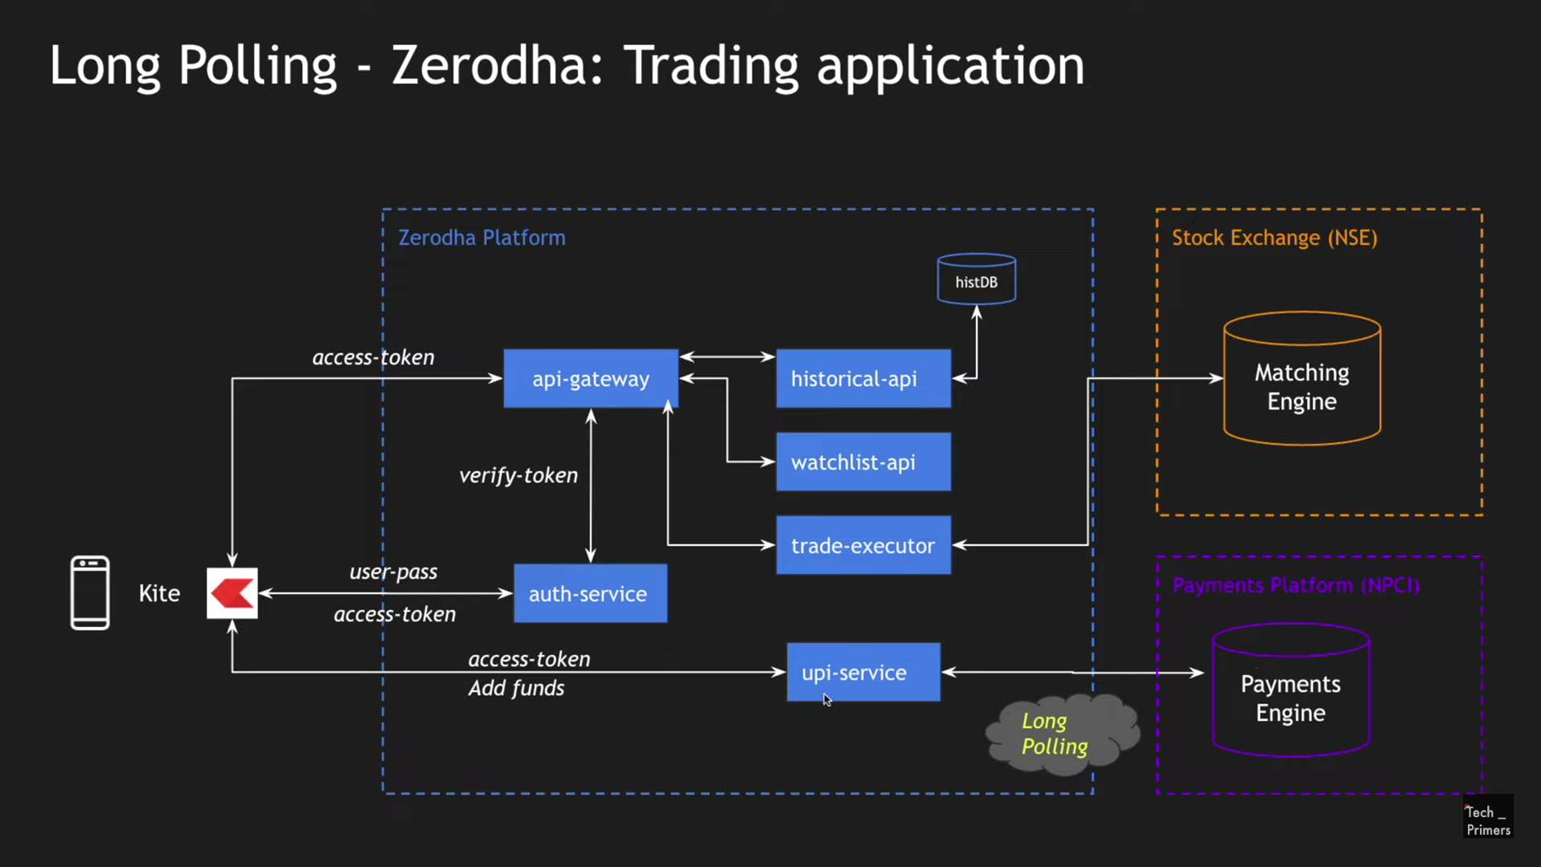

Slide 7
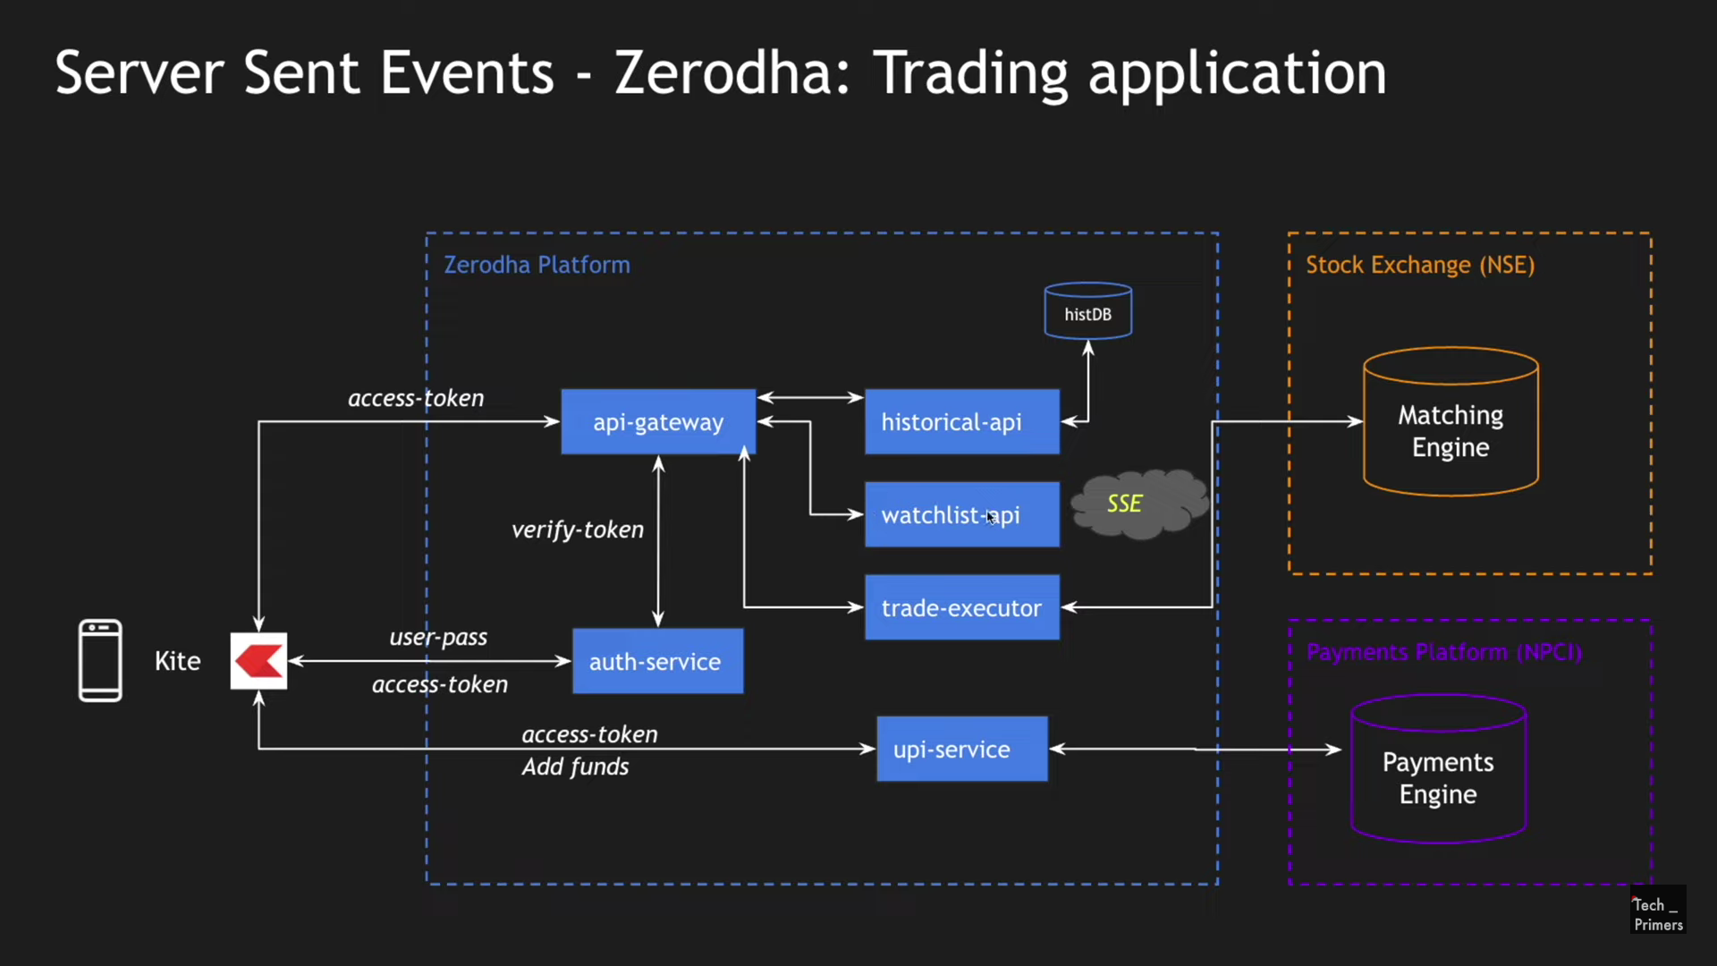

Slide 8
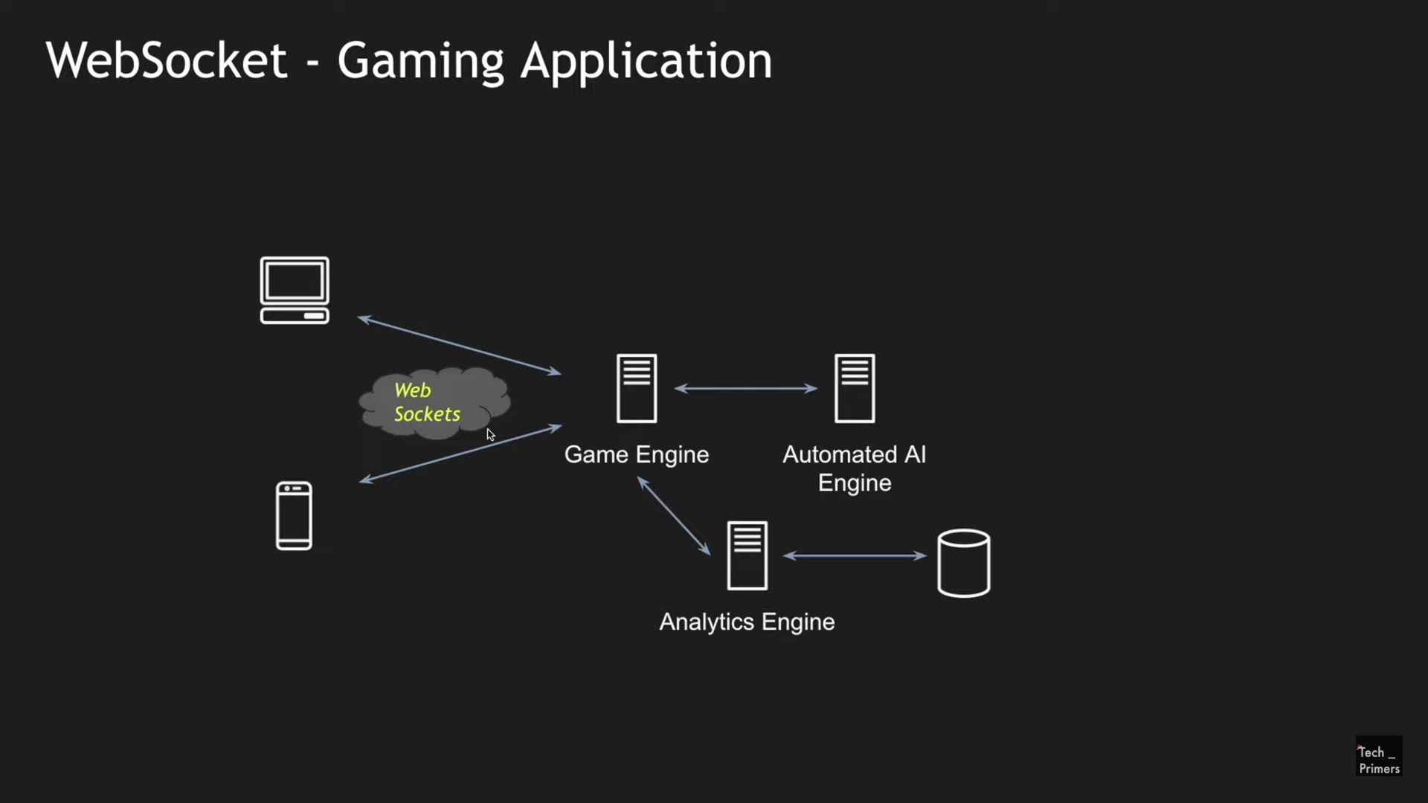

Slide 9
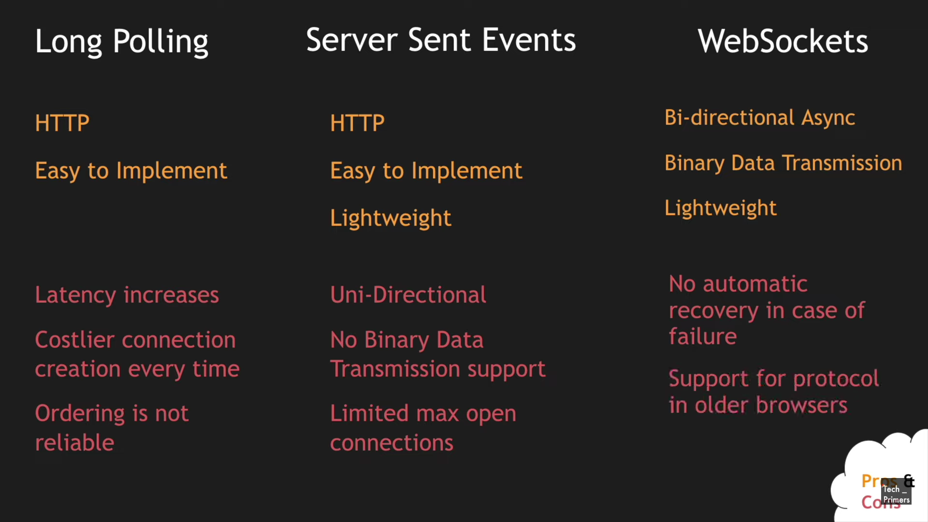

Slide 10
The HTTP request-response model is the primary communication model of the web.
In this model, a client (usually a browser) sends a request for a resource to a server, the server processes the requests, then sends back a response accordingly.
For this communication to happen, both the server and the client must establish a connection (e.g., a TCP connection), and when the request-response cycle ends, the connection will be closed.
This model was sufficient for early web applications, because early websites were only displaying static content. But as the web evolved, the need arose to allow servers send data to clients without a client requesting it first. This led to push technology.

Slide 11
HTTP
Polling :
request → response. Creates a connection to the server, sends request headers with optional data, gets a response from the server, and closes the connection.
Supported in all major browsers.
Supports unidirectional communication where only server can send the data on clients request.
Uses HTTP protocol for the communication.
Avoid polling as its an old technique to get the data from the server.

Slide 12
Server-sent events
request → wait → response.
Creates a connection to the server, but maintains a keep-alive connection open for some time (not long though). During connection, the open client can receive data from the server.
Supports unidirectional communication where only server can send the data to client.
Uses HTTP protocol for the communication.
SSE can be used when we only want to send the data from server to client.
Ex:
– Streaming platforms

Slide 13
Web Socket
client ↔ server.
Create a TCP connection to the server, and keep it open as long as needed.
The server or client can easily close the connection. The client goes through an HTTP compatible handshake process.
If it succeeds, then the server and client can exchange data in both directions at any time.
Supports bidirectional communication where server as well as client can send the data over the network
Uses websocket protocol for the communication.
Examples are as below –
– Chat applications
– Gaming

